Slide 1
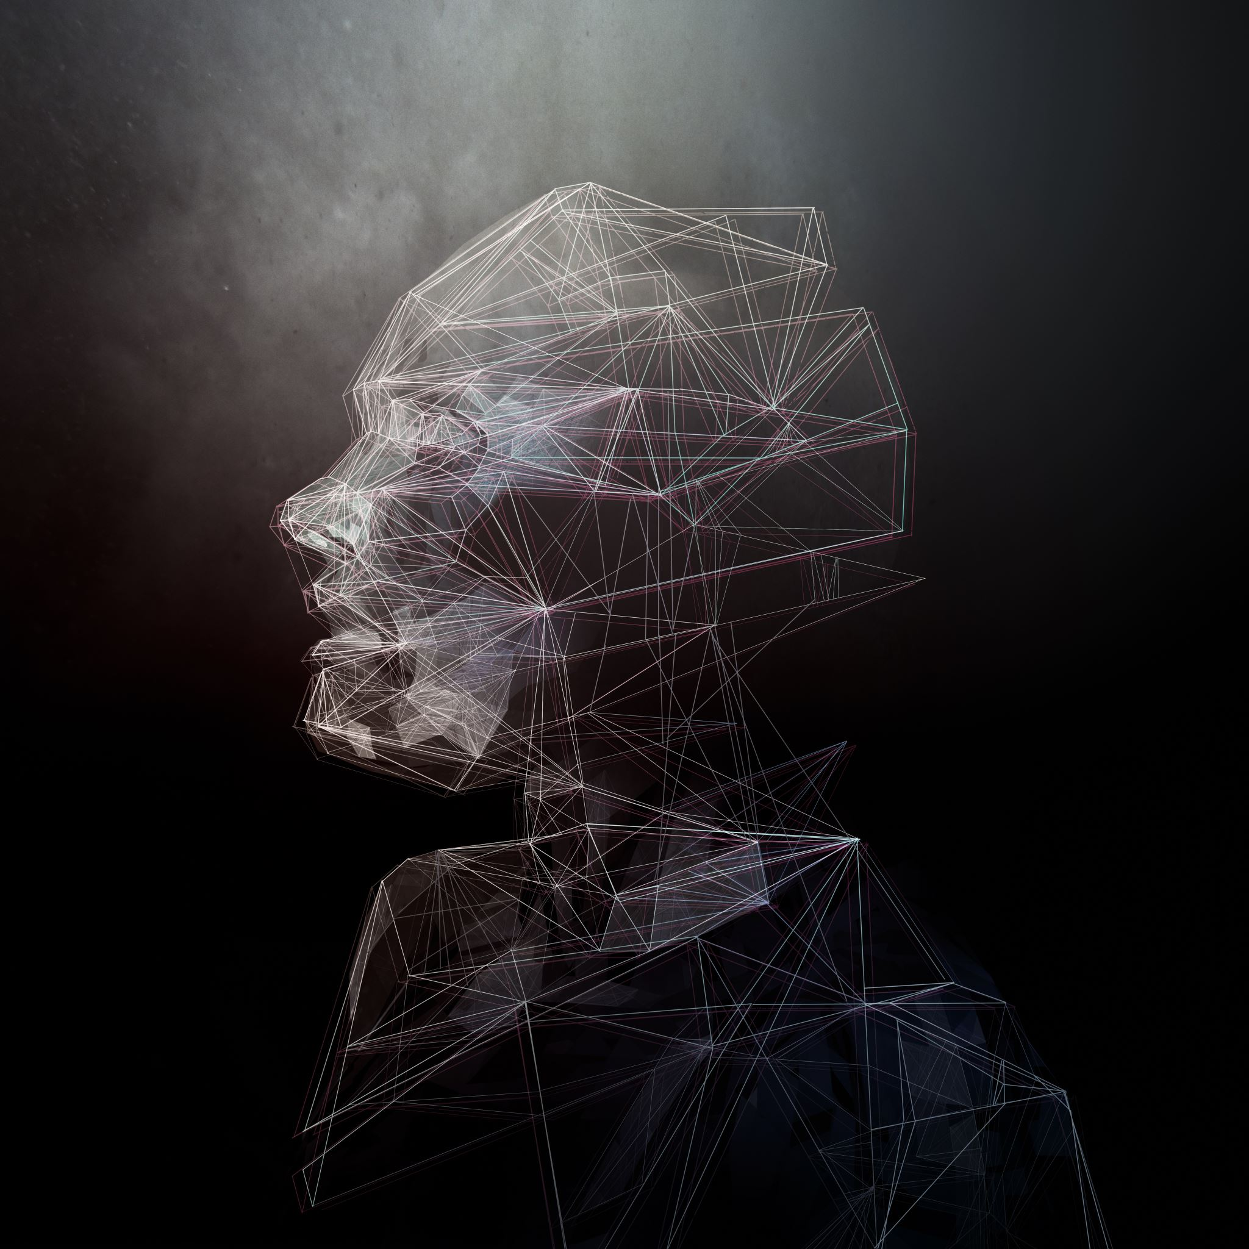
Face recognition for attendance checking

Slide 2
Represent by
Amanpreet kaur
Ramandeep kaur
prabhkirat singh

Slide 3
Face recognition for attendance checking
A facial recognition system is a technology capable of identifying or verifying a person from a digital image or a video frame from a video source. There are multiple methods by which facial recognition systems work but in general they work by comparing selected facial features from given image with faces within a database.

Slide 4
How face recognition works ?
The mathematical algorithms of biometric facial recognition follow several stages of image processing:
CAPTURE the first step is for the system to collect physical or behavioral samples in predetermined conditions and during a stated period of time.
EXTRACTION then, all this gathered data should be extracted from the samples to create templates based on them.
COMPARISON after the extraction, collected data is compared with the existing templates.
MATCHING the final stage of face detection technology is to make a decision whether the faces’ feature of a new sample are matching with one from facial database or not.

Slide 5
Introductory background
Traditionally, students’ attendance records are taken manually by teachers through roll calling in the class, or the students are required to physically sign the attendance sheet each time for the attendance of each class, in order to replace traditional attendance, we propose a more convenient and intelligent attendance system which is implemented using facial recognition.
Along with the rapid development of technology, it needs to be balanced with appropriate security enhancements so that users are comfortable with the personal information on the technology. Face is one of the most popular types of biometrics at the moment. The face dominates as biometrics which is most increase in the next few years, which is 38%, followed by multimodal (22%), iris (11%), and fingerprint 9% [1].

Slide 6
Common face recognition algorithms
Eigenfaces: Eigenfaces uses principal of component Analysis. It is an appearance based approach which captures the variation in a collection of face images. It then uses this data to compare different face images in a holistic manner.
Fisherfaces: This method is an enhancement of the Eigenface method. It uses Fisher’s Linear Discriminant Analysis(FLDA or LDA) for the dimensionality reduction.
Local Binary Patterns Histograms: Local Binary Patterns Histogram is a simple yet very efficient texture operator which labels the pixels pf an image by thresholding the neighborhood of each pixel and considers the result as a binary number and then visualize the results as histograms.

Slide 7
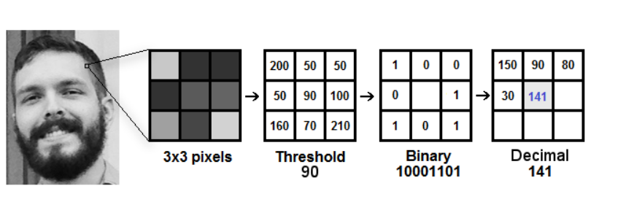
Local binary patterns histograms face recognizer
LBPH is a very popular face recognizer model, and it is significant improvement over Eigenfaces and Fisherfaces as both of these are affected by light as they try t look at the facial image as a whole. LBPH, .however , tries to find the local structure of the image as it compares each pixels to its neighboring pixels.

Slide 8
More
LBPH (Local Binary Pattern Histogram) is a Face-Recognition algorithm it is used to recognize the face of a person. It is known for its performance and how it is able to recognize the face of a person from both front face and side face.

Slide 9
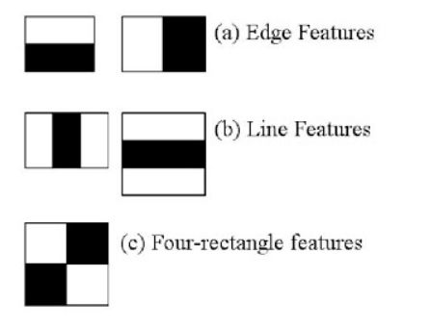
Haar Cascades Classifier
It is a classifier in which the cascade function is trained by superimposing the positive image over a set of negative images.
It uses Haar features and Integral Images.
It helps in the stages of Face Detection and Feature Extraction.

Slide 10
Methodology
Face detection: Pre-processing Images and making a training database with Haar Cascades.
Feature Extraction: Haar Features, Integral Images, Cascade Classifier, and Training model.
Face Recognition: Testing in Real-Time with local binary patterns histograms face recognizer.
Tools used
Python 3.9 Anaconda(Pycharm)
opencv

Slide 11
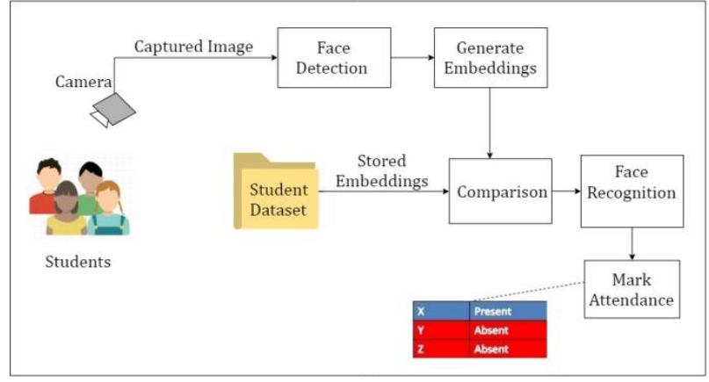

Slide 12
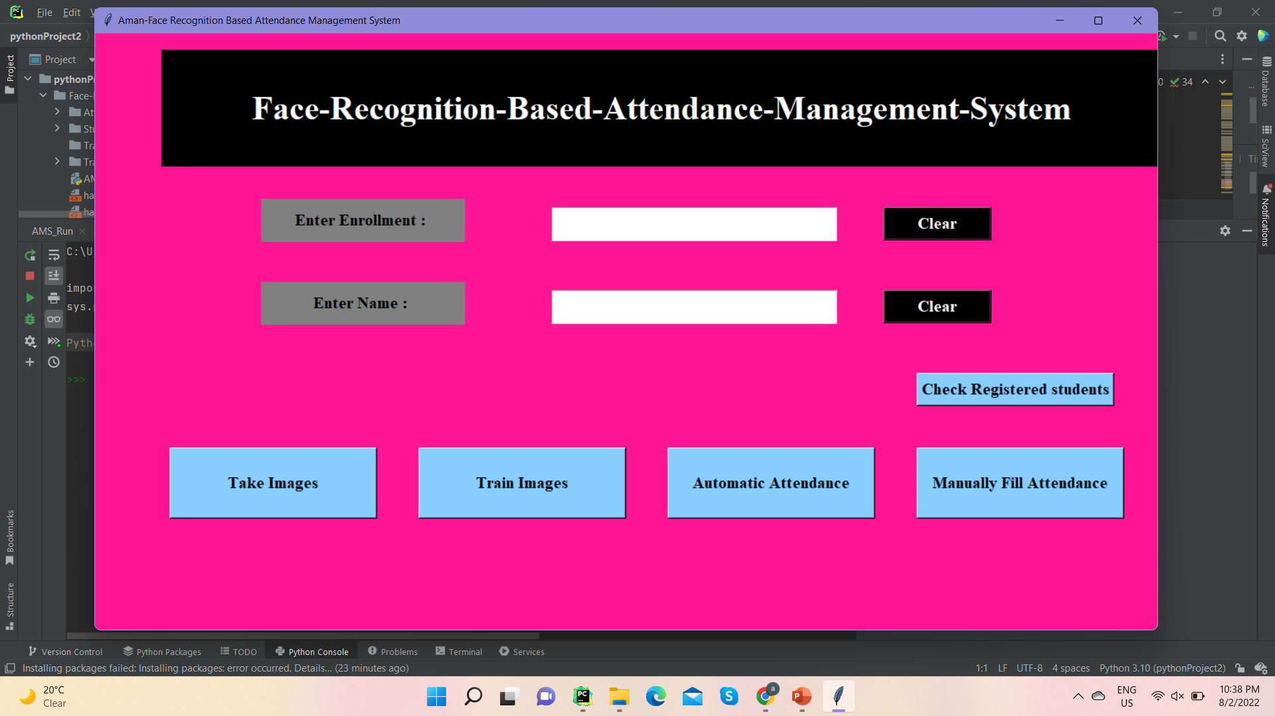
main

Slide 13
Coding for main
import tkinter as tk from tkinter import * from tkinter import Label import cv2 import csv import os from PIL import Image, ImageTk import pandas as pd import datetime import time import numpy as np # Window is our Main frame of system window = tk.Tk() window.title("Aman-Face Recognition Based Attendance Management System") window.geometry('1280x720') window.configure(background='deep pink')

Slide 14
Take img code
def take_img(): l1 = txt.get() l2 = txt2.get() if l1 == '': err_screen() elif l2 == '': err_screen() else: try: cam = cv2.VideoCapture(0) detector = cv2.CascadeClassifier( 'haarcascade_frontalface_default.xml') Enrollment = txt.get() Name = txt2.get() sampleNum = 0 while (True): ret, img = cam.read() gray = cv2.cvtColor(img, cv2.COLOR_BGR2GRAY) faces = detector.detectMultiScale(gray, 1.3, 5) for (x, y, w, h) in faces: cv2.rectangle(img, (x, y), (x + w, y + h), (255, 0, 0), 2) # incrementing sample number sampleNum = sampleNum + 1 # saving the captured face in the dataset folder cv2.imwrite("TrainingImage/ " + Name + "." + Enrollment + '.' + str(sampleNum) + ".jpg", gray) print("Images Saved for Enrollment :") cv2.imshow('Frame', img) # wait for 100 miliseconds if cv2.waitKey(1) & 0xFF == ord('q'): break # # # break if the sample number is morethan 100 elif sampleNum > 70: break

Slide 15
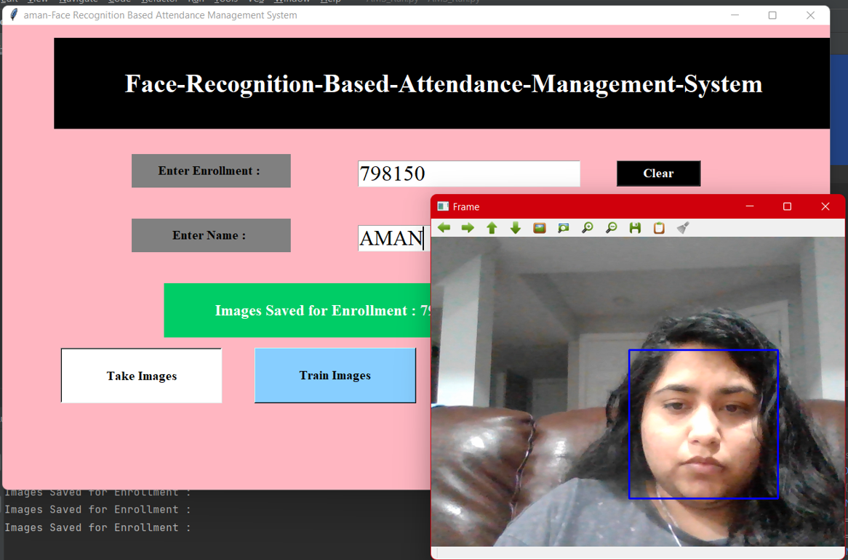
Taking image from video cam

Slide 16
Train model
def trainimg(): recognizer = cv2.face.LBPHFaceRecognizer_create() global detector detector = cv2.CascadeClassifier("haarcascade_frontalface_default.xml") try: global faces, Id faces, Id = getImagesAndLabels("TrainingImage") except Exception as e: l = 'please make "TrainingImage" folder & put Images' Notification.configure(text=l, bg="SpringGreen3", width=50, font=('times', 18, 'bold')) Notification.place(x=350, y=400) recognizer.train(faces, Id) try: recognizer.save("Trainner.yml") except Exception as e: q = 'Please make "TrainingImageLabel" folder' Notification.configure(text=q, bg="SpringGreen3", width=50, font=('times', 18, 'bold')) Notification.place(x=350, y=400) res = "Model Trained" # +",".join(str(f) for f in Id) Notification.configure(text=res, bg="olive drab", width=50, font=('times', 18, 'bold')) Notification.place(x=250, y=400)

Slide 17
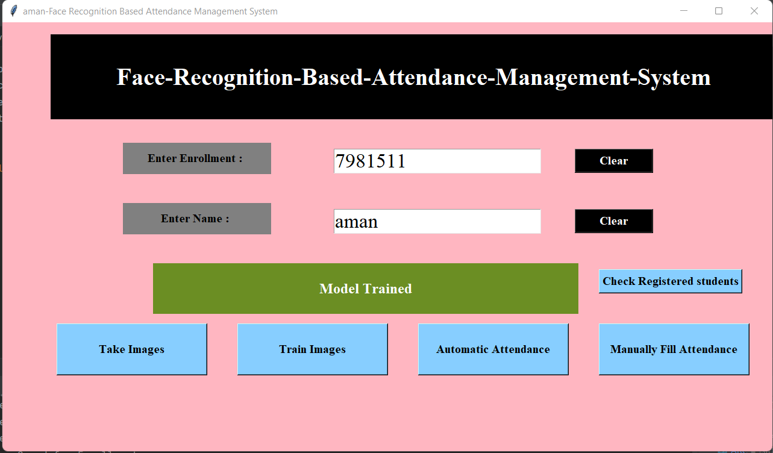
Model trained

Slide 18
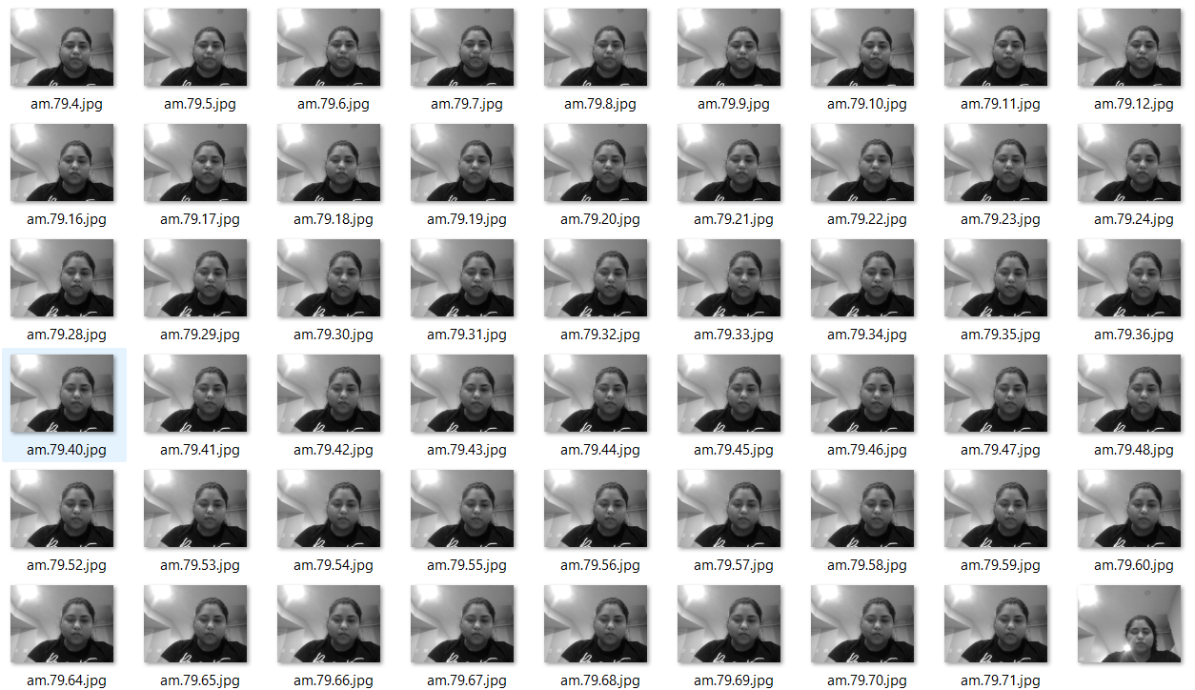
Training
200 training images generated by the algorithm using haarcascade_frontalface_default.xml from haar cascades, so 200 histograms.
Crops images to 200*200 pixel values and reduces RGB images to grayscale with 8bits per pixel.
During testing , the algorithm again creates histogram from the test image , and it compares that with the training histograms to try to get a match.

Slide 19
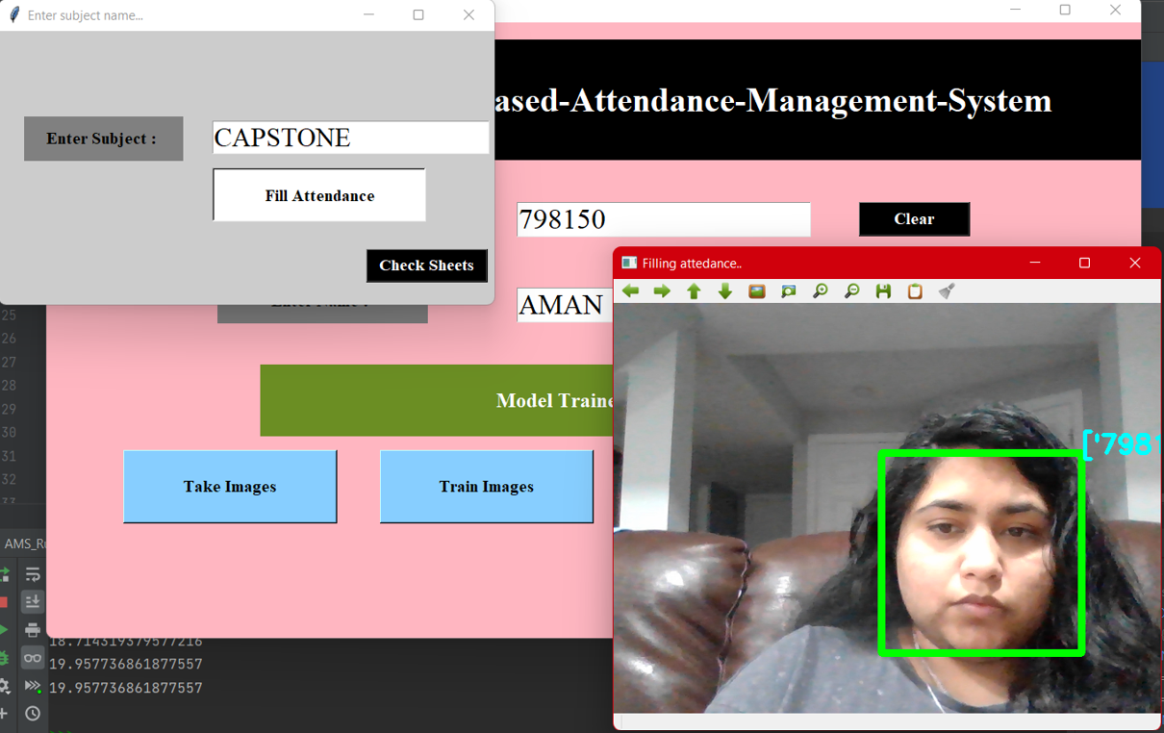
Automatic fill attendance

Slide 20
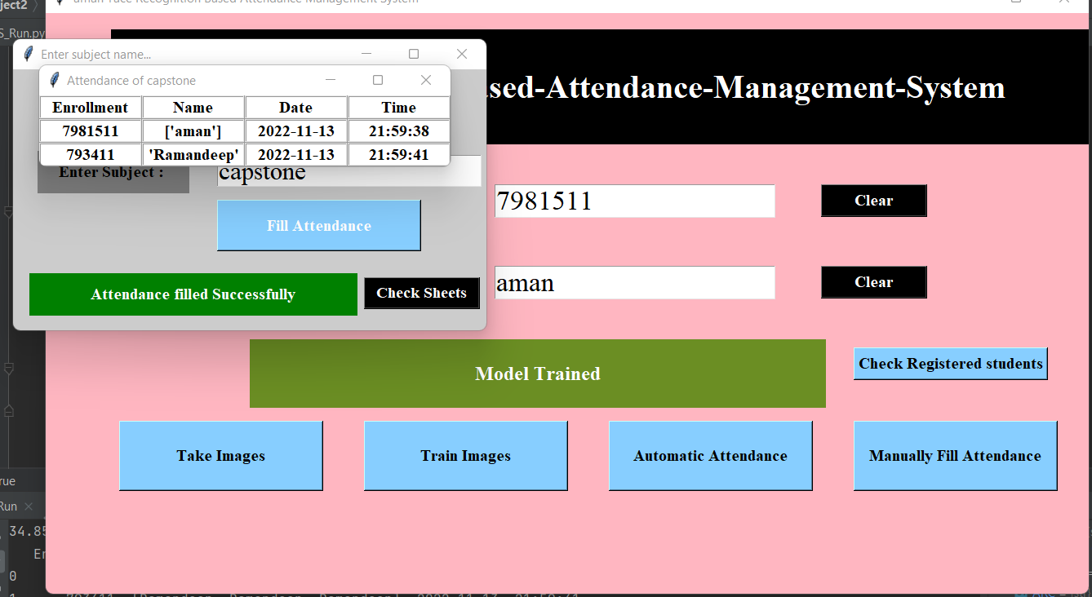
Attendance filled

Slide 21
refrences
https://www.slideshare.net/NaomiKulkarni/face-recognition-attendance-system-85321885
https://github.com/Manvityagi/Face-Recognition-using-KNN-openCV

